Slide 1
Flux and The Convection-Diffusion Equation
Kevin Gottlieb
MV Calc 2017

Slide 2
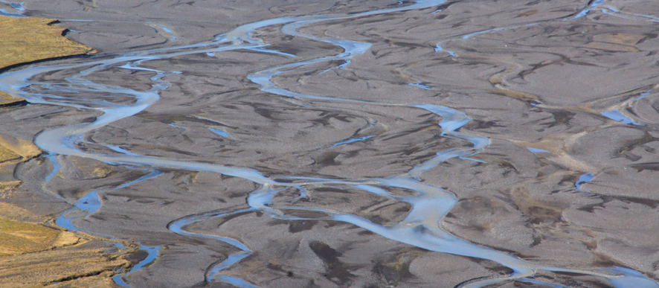
The Problem
Notes:
Silt moving through flowing water
Water has velocity and silt diffuses as well
Flux (change of concentration across surface) of silt
Besides a surface, we need one more thing to take flux: ?
Vector field that represents movement of silt

Slide 3

Advection and Diffusion
Diffusion – motion from higher to lower concentration
${\vec{F}}_{diffusion}=−D\vec{∇}c$
Advection (Convection) – bulk motion, eg. velocity of water flow
${\vec{F}}_{advection}=\vec{v}c$
$\vec{F}=−D\vec{∇}c+\vec{v}c$
Notes:
Diffusion
Draw surface on board
Imagine c(x,y) maps concentration to every point on xy-place
If we place a particle of silt somewhere, in what direction will it go?
$−∇c$
Add D: diffusivity constant
Advection
Draw water flow in one direction on 3D
Indicate area of high concentration, what happens here?
A lot moves
Indicate area of low concertation, what happens here?
Less moves
Relationship? (know direction already, but looking for a scalar multiple of $\vec{v}$
Directly proportional to concentration
Total vector field is the sum of the two sources of motion

Slide 4

The Equation
Continuity Equation: $\frac{∂c}{∂t}+∇⋅\vec{F}=R$
The Convection-Diffusion Equation: $\frac{∂c}{∂t}=∇⋅\left(D\vec{∇}c\right)−∇⋅\left(\vec{v}c\right)+R$
Incompressible Flow ($∇⋅\vec{v}=0$ and $D$constant)
Simplification: $\frac{∂c}{∂t}=D{\vec{∇}}^{2}c−\vec{v}⋅\vec{∇}c$
Notes:
We know a general form for the vector field of silt motion, but we don’t know c
Continuity equation
Change in concentration (from other source such as heat)
plus amount of concentration coming from motion
= generation – amount of silt generated, per unit time
Plug in
What is each term?
1st – diffusion
2nd – advection
3rd – generation
Simplification
Why?
Steady state
Use this equation to find c at diff times

Slide 5

Flux
$c\left(x,y,z\right)=x^{2}z^{2}+y^{3}$
Compute $∫\int_{σ}{\vec{F}⋅\vec{n}dS}$
for $σ:y=0, x∈\left[−1,1\right], z∈[−1,1]$
oriented y+
$\vec{v}=\vec{j}$
$D=1$
$∫\int_{σ}{\vec{F}⋅\vec{n}dS}=\frac{4}{9}$
Notes:
$=∫\int_{σ}{\left(−\vec{∇}c+\vec{j}c\right)⋅\vec{j}dS}$
$=\int_{−1}^{1}{\int_{−1}^{1}{\left(c−\frac{∂c}{∂y}\right)dxdz}}=$
Show Animation

Slide 6
Works Cited
https://en.wikipedia.org/wiki/Convection%E2%80%93diffusion_equation#Derivation
https://en.wikipedia.org/wiki/Continuity_equation#Differential_form
http://demonstrations.wolfram.com/SteadyStateTwoDimensionalConvectionDiffusionEquation/

